Slide 1
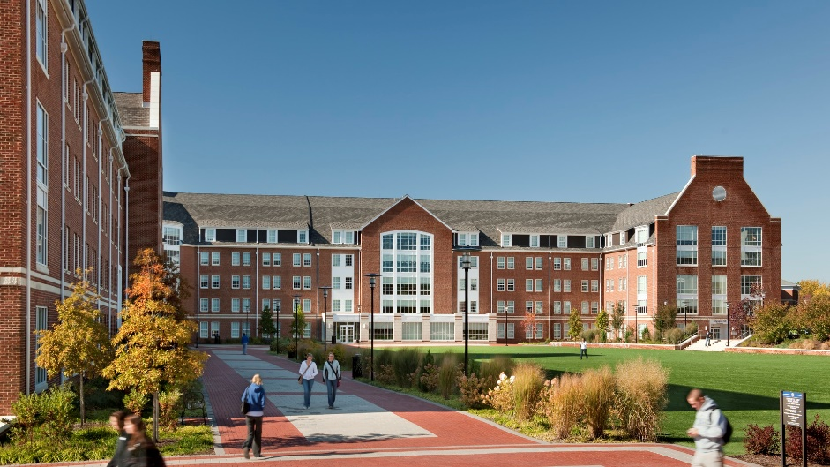
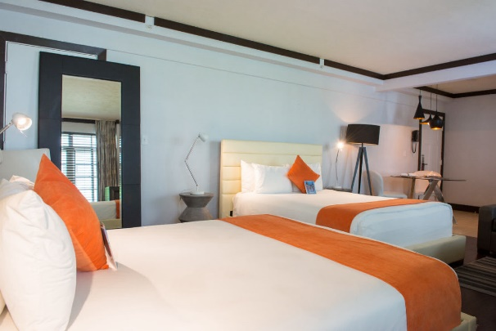



HOUSING MANAGEMENT SYSTEM

Slide 2
Team Members
Suhas Balanagar : 001356872
Ankita Moharir : 001356837
Anuja Suryawanshi : 001383812

Slide 3
PROBLEM STATEMENT
To develop an application for managing various activities on university housing. Due to an increase in number of students, it has become very difficult for universities to maintain, handle the accommodation and food services . Also it has become very difficult to handle the management functionalities and services manually.
This project provides a solution and improvises the existing system of the housing department to provide faster and better services for students who choose these university accommodation services.

Slide 4
Need
The existing system is an outdated system with limited data of the students
All students records and their accommodation details are entered and retrieved manually (i.e. On paper work)
The current system being manual, the management does not have updated records of student details, their health reports and food preferences
The lack of information about their health and food causes some students to be sick very often
Existing system is time consuming

Slide 5
Our Solution
The application developed will help in avoiding the problems which occur when carried out manually
The management routes the existing student’s data through multiple organizations
This application will reduce the manual errors and avoid redundancy
Accurate information regarding the student's accommodation details, health details and diet details will be stored in this application
Easy and hassle-free services for students by management

Slide 6
Terminologies used
R & R
Assigning roles and responsibility as per the intricacies of task and subject knowledge.
Design
Designing an object model that can address the problem statement.
User Interface
Engineering an interactive user interface which is easy to use.
Implementing
Implementing the program in Java Swing framework.
Validations
Carrying out the validations so that there is minimal risk of breaking of program while running.
Conducting a though research on the current student housing process in different universities worldwide.
Research

Slide 7
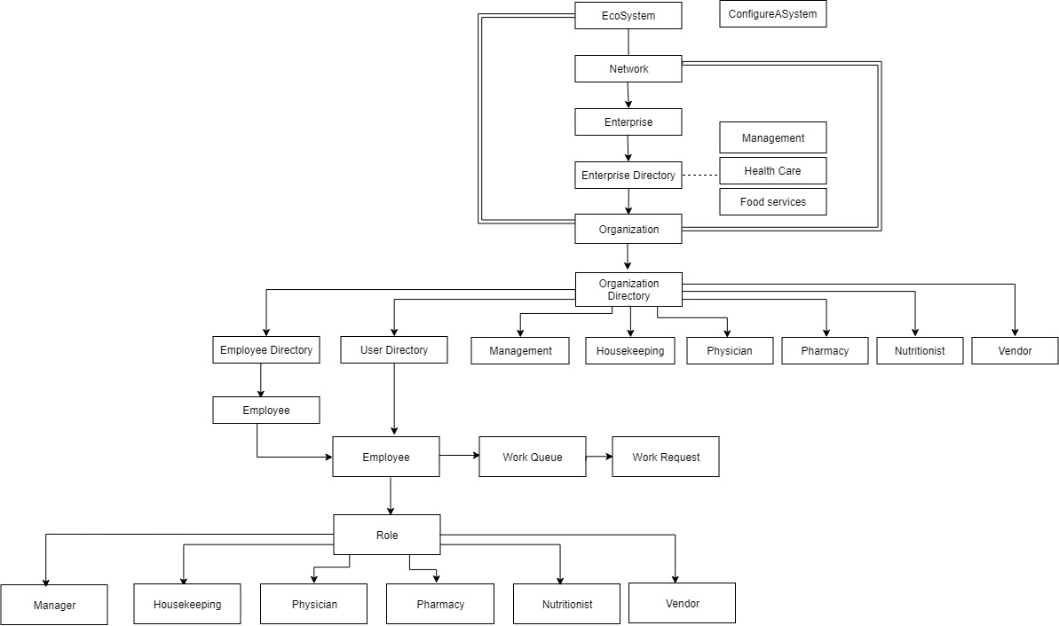
Object Model

Slide 8
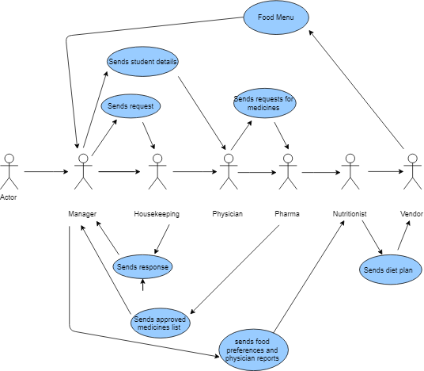
Use Cases

Slide 9
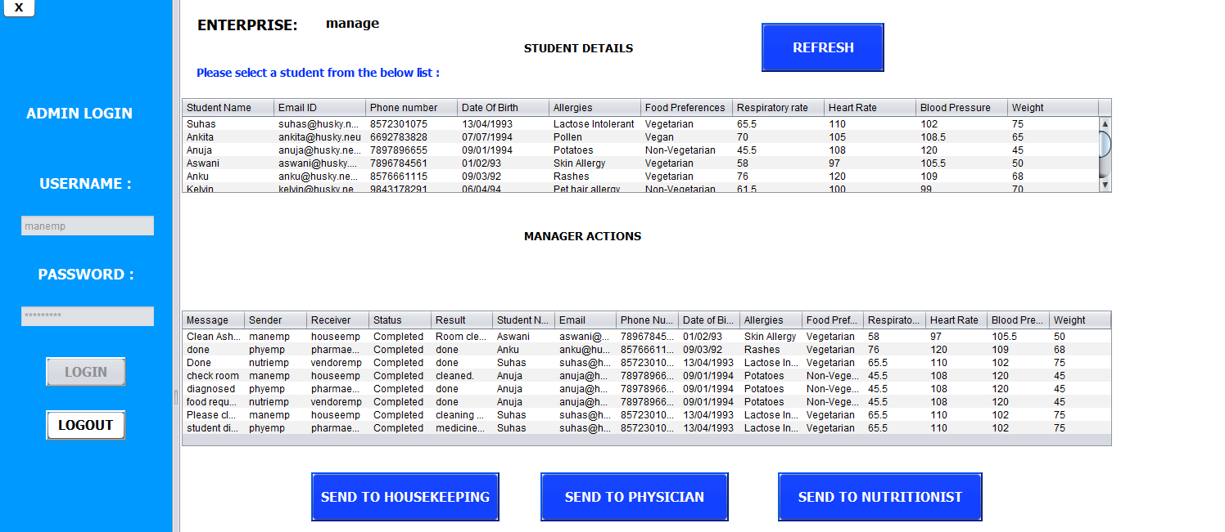
Manager Portal – Workarea for manager

Slide 10
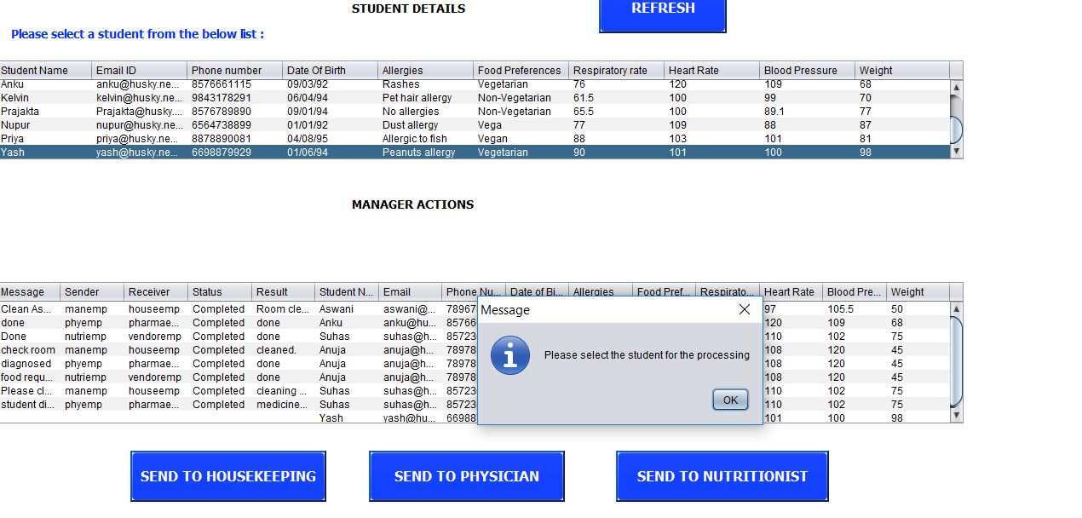
Manager portal when student is selected – It asks to select the student row for further processing

Slide 11
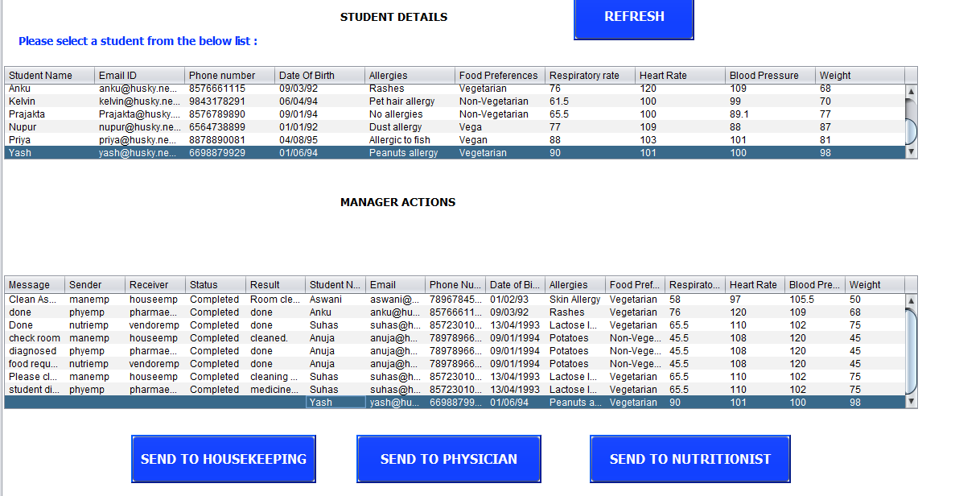
Manager portal- Sending student details to housekeeping organization

Slide 12
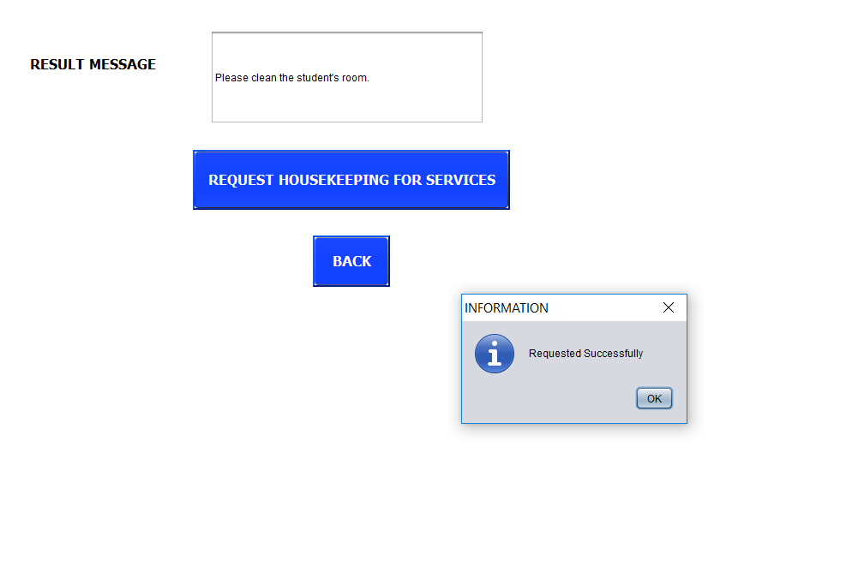
Manager requesting the housekeeping organization for services

Slide 13
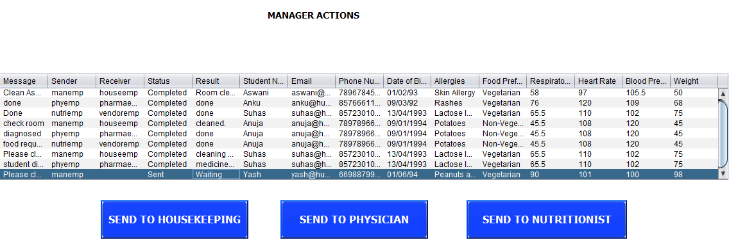
Once manager requests the housekeeping, the status is updated in Manager work area

Slide 14
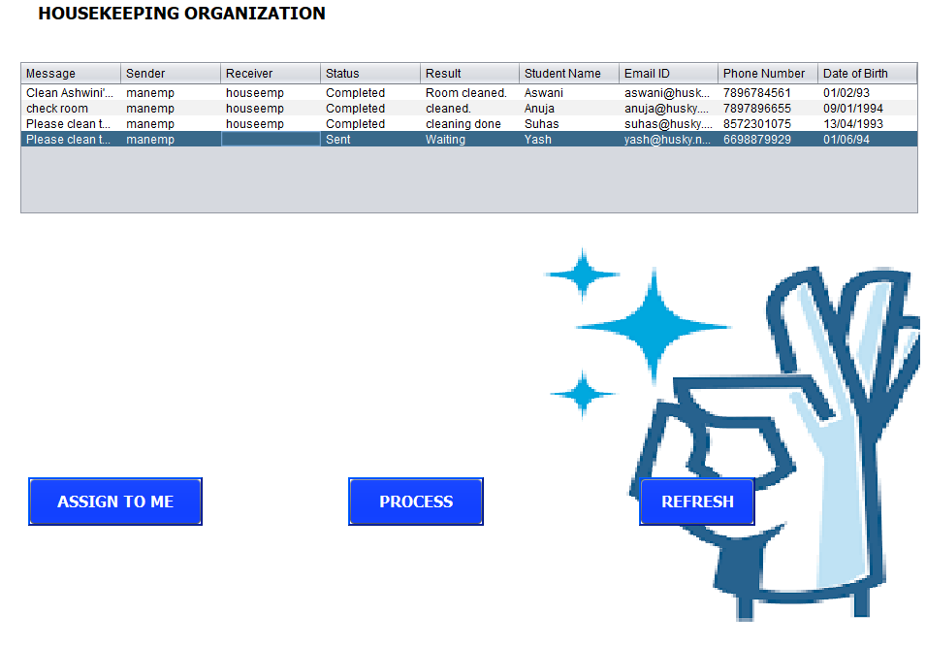
Housekeeping Organization – the request received from the manager is waiting

Slide 15
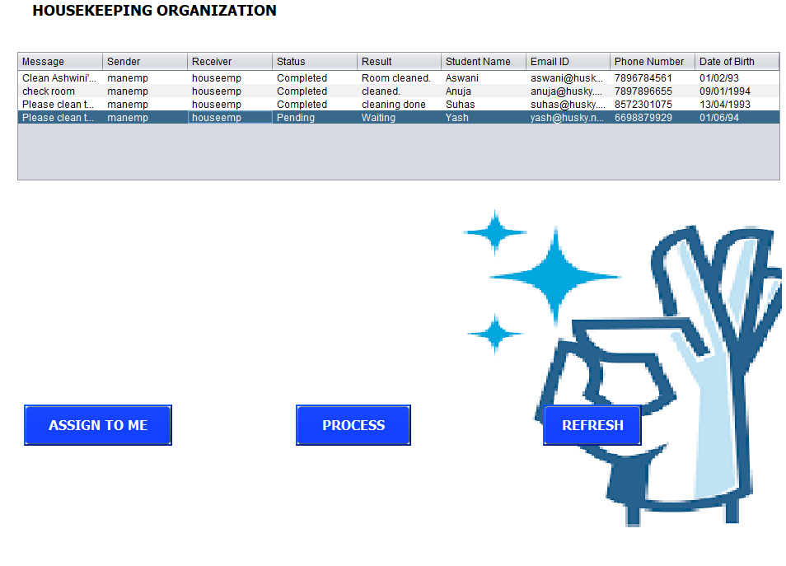
When the housekeeper assigns the task, the status is updated to pending

Slide 16
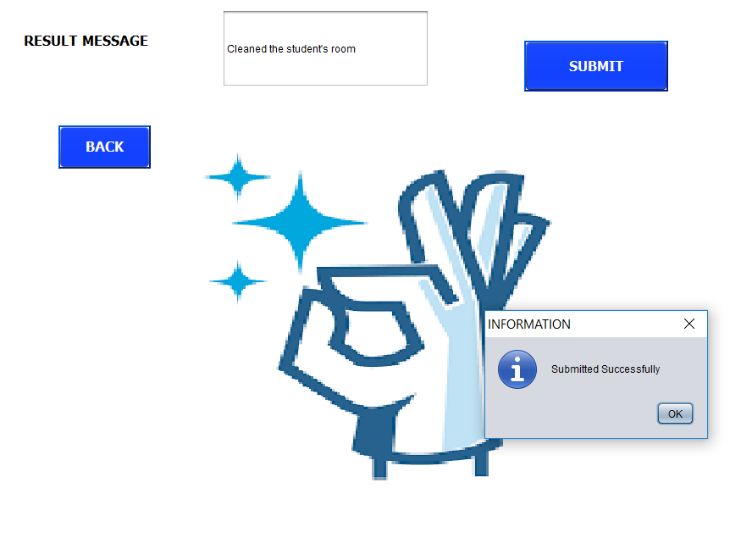
Housekeeping sends update to the manager once the task is done

Slide 17

The status is updated to completed once the result is sent to the manager

Slide 18
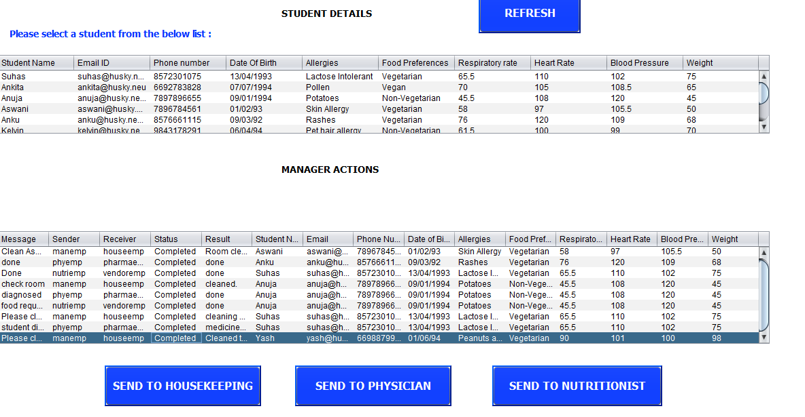
The status is updated once it is received from the housekeeping organization and the request is sent to physician for further processing

Slide 19
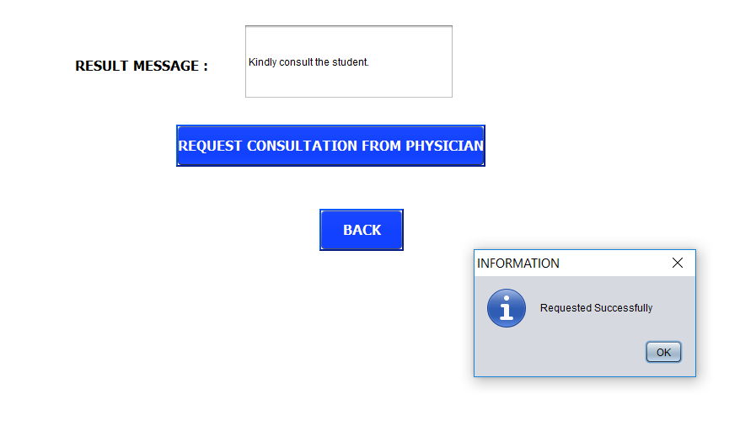
Manager requests the Physician to consult the student

Slide 20
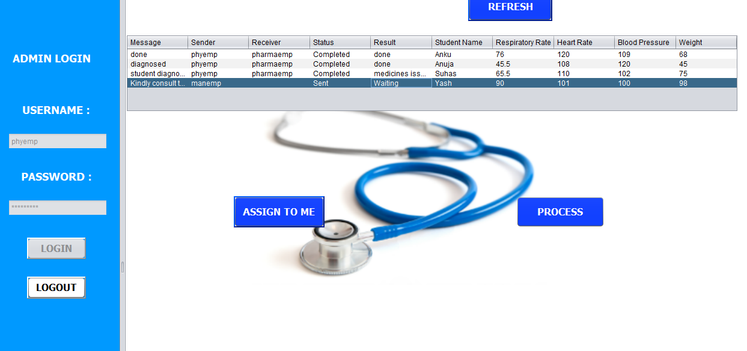
Physician Portal – The request is in waiting status which is sent from the manager

Slide 21
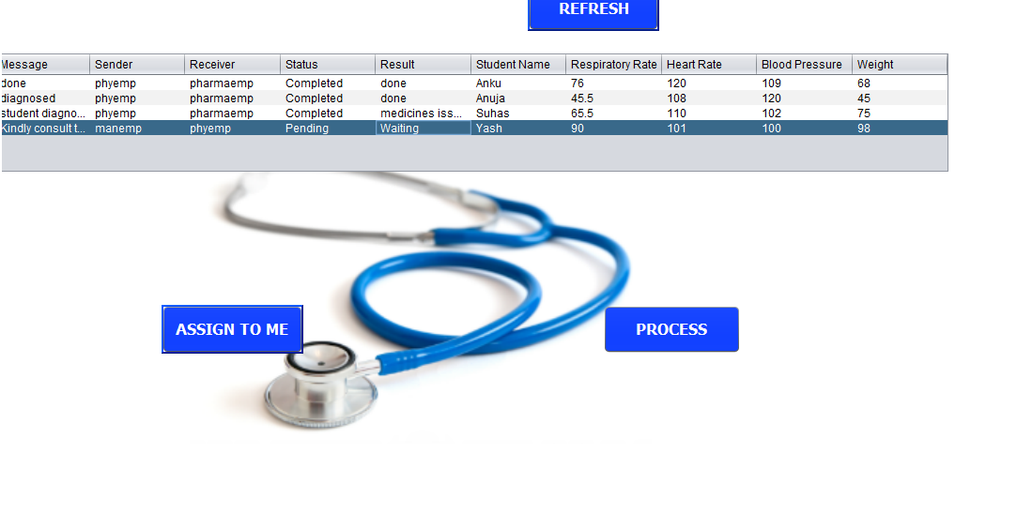
The Physician assigns the request and processes it

Slide 22
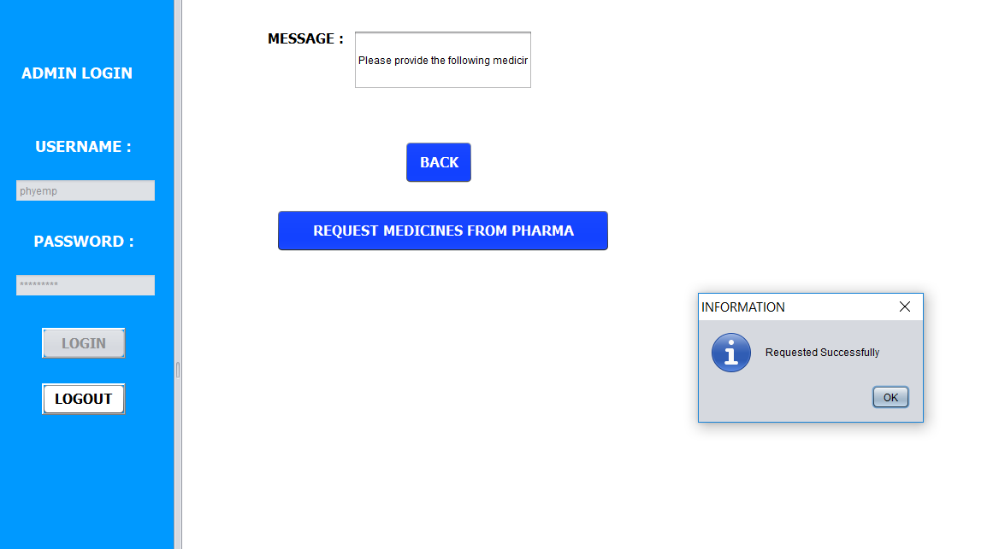
After consulting the Physician sends the request to Pharma organization

Slide 23
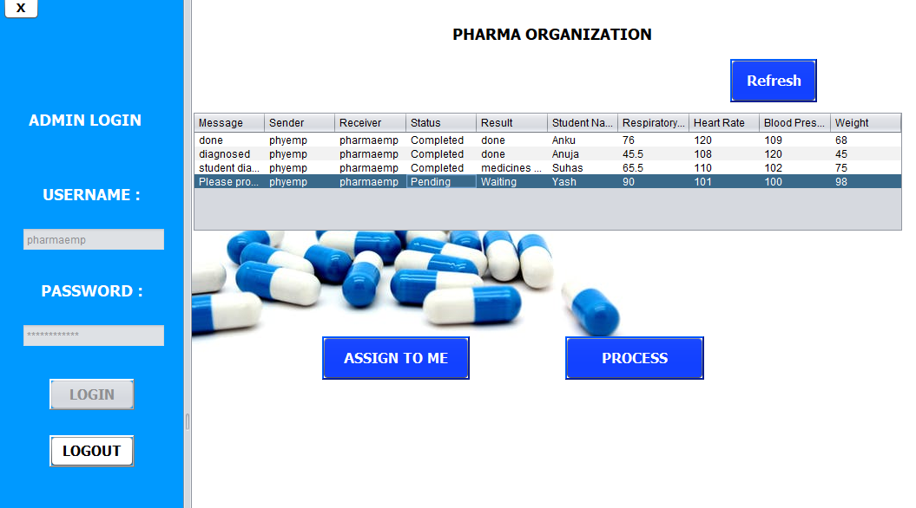
The request is assigned by an employee of Pharma organization and it is processed

Slide 24
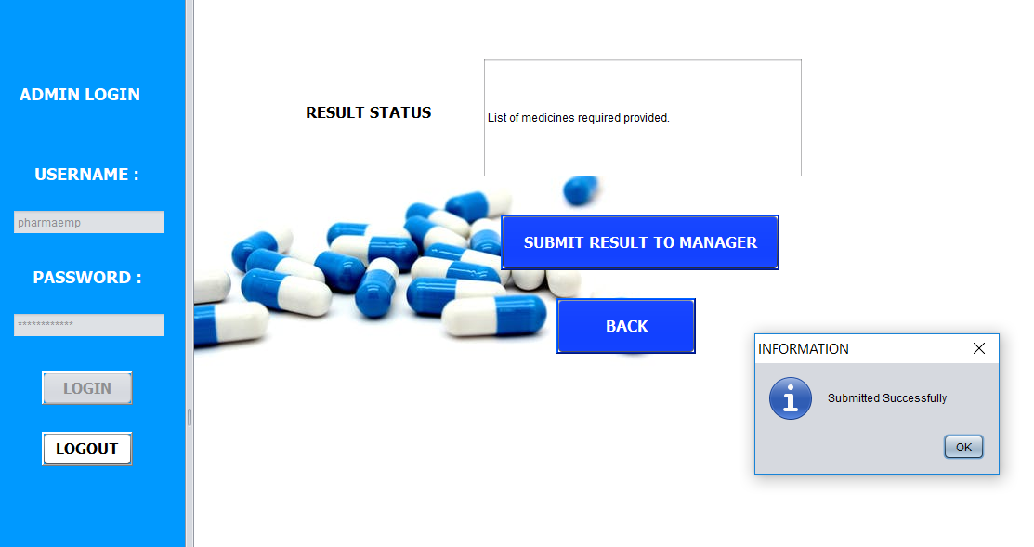
Once the medicines are provided, the request is sent back to manager stating completed

Slide 25
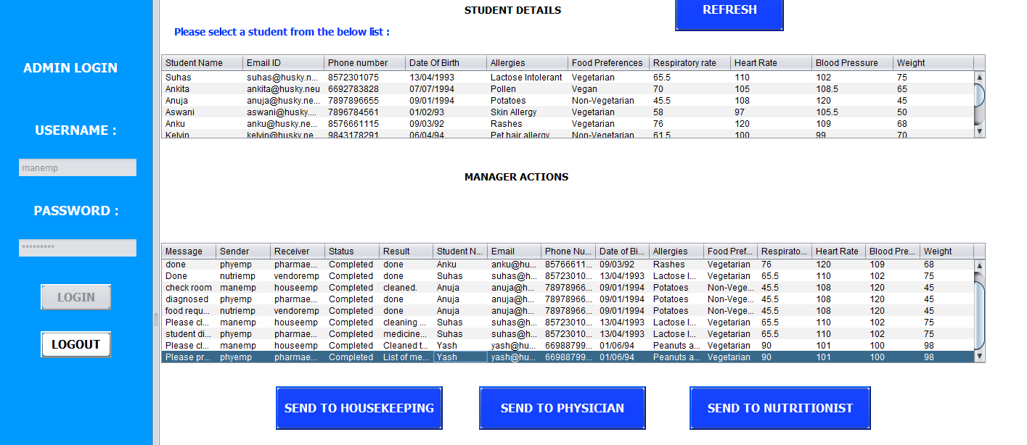
Once Pharma organization sends the completed request, it reflects in the manager portal

Slide 26
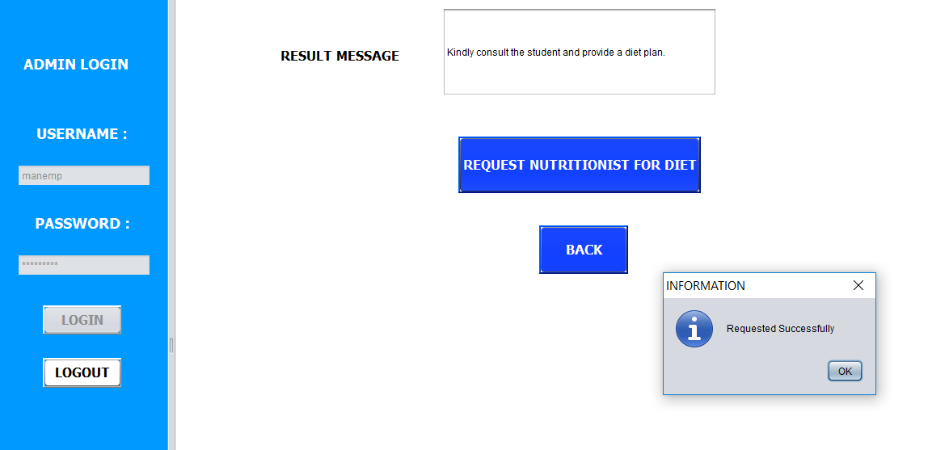
Manager then further sends the request to Nutritionist to create a diet plan

Slide 27
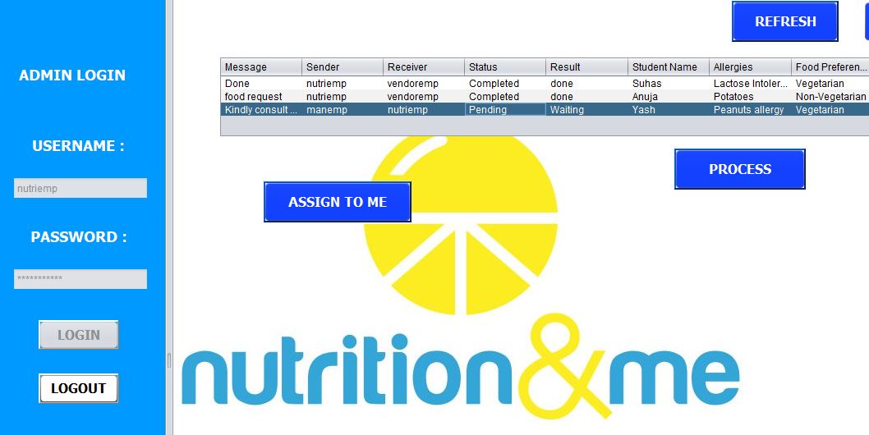
Nutrition Portal – The request is assigned and processed further

Slide 28
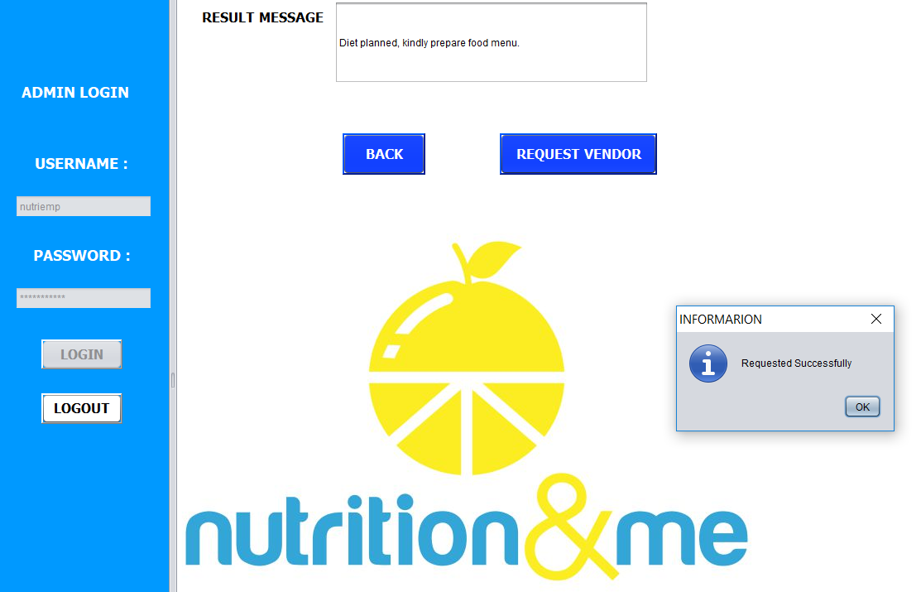
Once diet plan is prepared by Nutritionist, it is sent to the food vendor to create the food plan

Slide 29
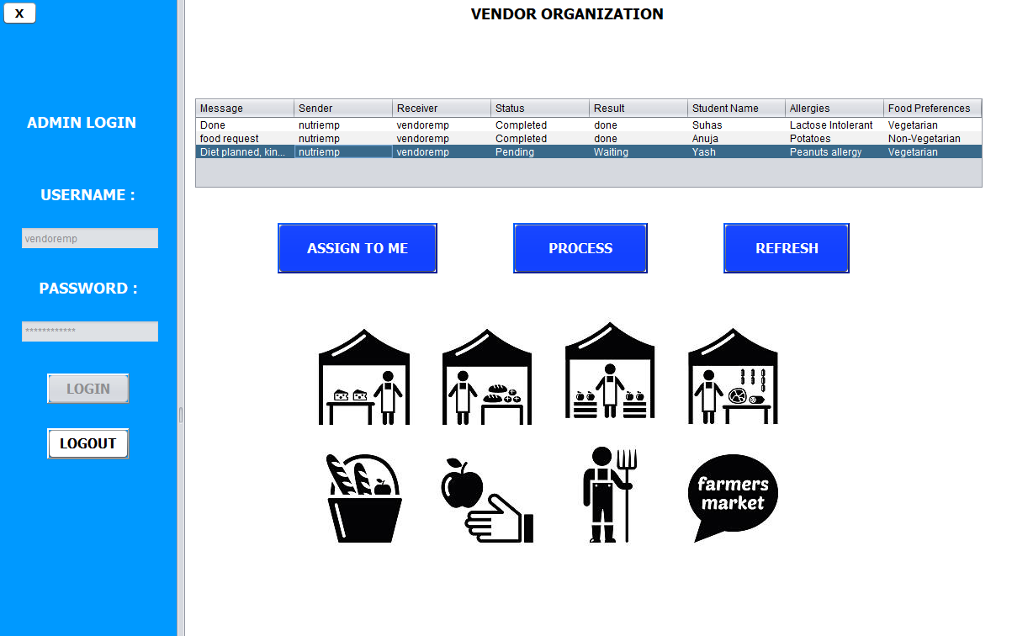
Vendor Portal

Slide 30
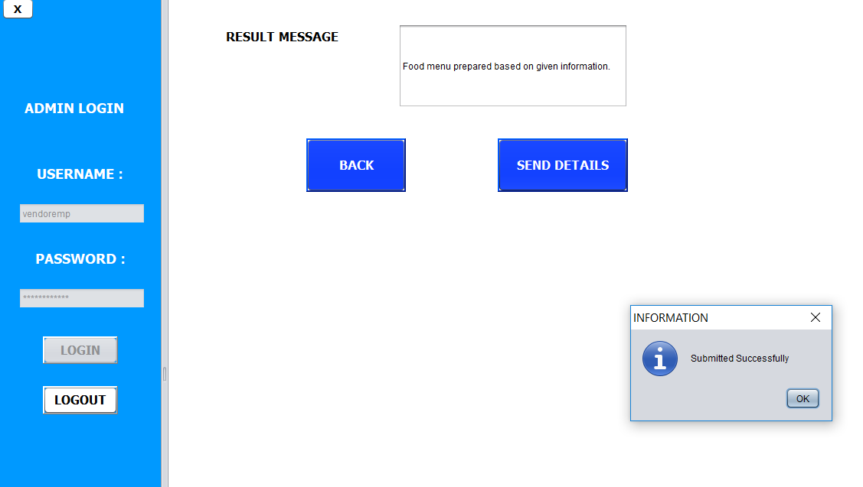
Once the food menu/plan is prepared for the student, the request is sent back to manager as completed

Slide 31
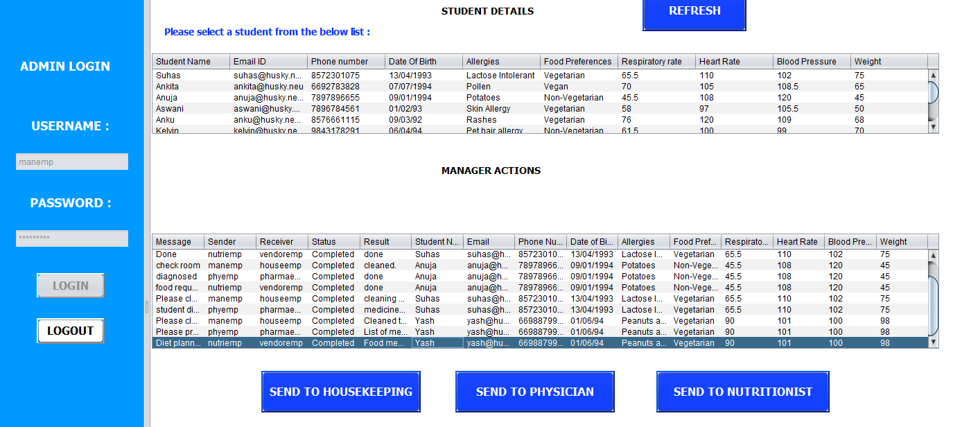
Manager portal once all the requests are completed

Slide 32
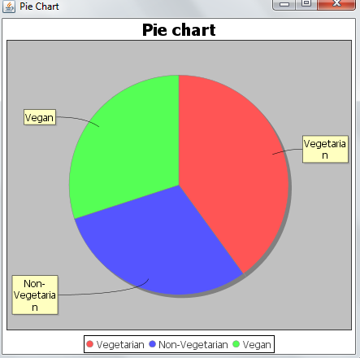
PIE chart depicting the food preferences of students

Slide 33
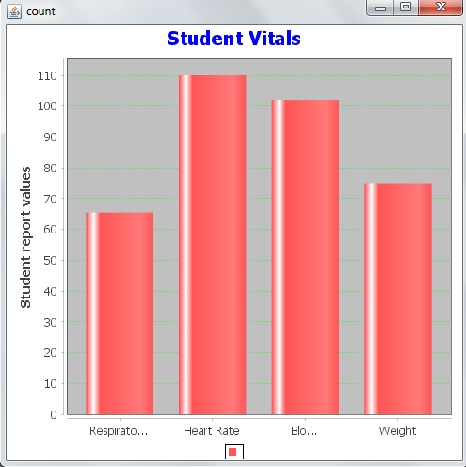
Bar graph depicting the student vitals

Slide 34
THANK YOU

